Slide 1
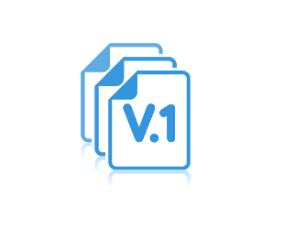
Introduction to Version Control

Slide 2
Objectives
Version control
What it is
Who needs it
Why we need it
Benefits
History of version control
Version control models
Distributed
Centralised

Slide 3
What is version control
The process of keeping track of a file as it evolves or changes by tracking what changed, when it was changed, who changed it, why it was changed and keeping a history of these.

Slide 4
Why do we need version control?
A history of what has been changed (audit trail).
Recovery of lost changes or files.
Point-in-time recovery.
Can you think of more?

Slide 5
Who needs version control?
Students.
Developers.
Writers.
Artists.
You.
Me.
Everyone.

Slide 6
Benefits of version control systems
Single user benefits include…
Automatic backups.
History of changes made (with information about such changes)
Undo.
Point-in-time recovery.
Workspace duplication (sandbox to try new things).
Benefits for multiusers include…
Audit trail of changes (who made what change, when and why)
Synchronisation of files.

Slide 7
History of version control systems
Stand-alone systems
SCCS (Source Code Control System):
Developed around 1972 by Bell Labs
Available on Unix platform
Single text files.
Closed source.
(SCCS saved original file and then change sets).

Slide 8
History of version control systems
Stand-alone systems
RCS (Revision Control System):
Developed around 1982.
Cross-platform (i.e. was not restricted to a single operating system).
Single text files
Open source.
(RCS saved latest file and undo information).

Slide 9
History of version control systems
Centralised systems
CVS (Concurrent Version System):
Developed around 1986
Used a centralised repository.
Multi-user system.
File-focused (could keep track of single files but not entire directories).

Slide 10
History of version control systems
Other centralised systems
Perforce: Developed in 1995.
Subversion: Developed in 2000, supports non-text files, can track entire directory/folder.
TFS (Team Foundation Server): Developed in 2004, visual studio integration, source code control and more…

Slide 11
History of version control systems
Distributed systems
No central server (but one can be configured)
Everyone has a copy of the set of files
Users can share changes with a server or other users
Examples of distributed version control systems are
Git: Developed in 2005
Mercurial: Developed in 2005

Slide 12
Version control models
Centralised system
The repository is always remote.
Every user has his/her working set locally but connected to the central system.
Users make changes and push them to the central (remote) repository.
Users can update their working set with changes that other users have pushed to the remote repository.
Distributed system
Everyone owns his/her working set which is unconnected to the others.
Remote repository is optional (e.g. Github or a privately set up one).
Export and import to exchange changes.

Slide 13
Centralised model
Push/Pull
Push/Pull

Slide 14
Distributed model
Optional Server
Push/Pull
Push/Pull
Import/Export

Slide 15
Centralised model
Advantages
There is centralised control.
Updates can be tracked centrally.
Backups are easier to manage.
Rollbacks for all at once are easier.
Disadvantages
Limited or no work when server is down.
Limited or no work when there’s no access to server e.g. airplane.

Slide 16
Distributed model
Advantages
No need to be connected to network.
Disadvantages
Can be tedious exporting changes to other users or importing changes from other users.

Slide 17
Difference between client/server & distributed model
Client-Server Model | Distributed model
Connects to a centralised server | Peer-to-peer approach
Single repository | Multiple repositories
Operations are slower due to server conn. | Operations are faster
Backup strategy needed | Multiple repositories means no need for extra backup strategy
Users cannot work without network conn. | Users can work without network conn.
Users need to be created before they can work | No need for permission. Any user can export his/her repository to new users.
Single point of failure | No single point of failure
Initial cloning of repository is faster | Initial cloning of repository may be slower depending on repository size.

Slide 18

Using Git

Slide 19
Objectives
Initialising a Git repository
Adding and committing changes.
Writing commit messages.
Git log
Git tree architecture (three-tree architecture)
Commits and hash values
Git states
Git head pointer
Git status

Slide 20
Initialising a repository
In order to begin version control with Git, we need tell Git what folder we want to track. We do this by…
Creating (if not yet created) and/or navigating to the folder through Git Bash
And then running the command
The files we are interested in keeping track of, will be stored in this folder.
cd <project_location>
git init

Slide 21
Initialising a repository
Initialising a repository creates a hidden folder with the name .git
This folder is stored at the top of the directory tree which we are interested in tracking.
This is where Git stores all the information it needs to do version control.
Users should normally not interfere with the content in the folder.

Slide 22
Adding changes
To add all changes made inside our folder to Git, we use the command
To add changes in a single file, we need to specify the file
We can also specify more than one file
Enclose file name with double quotes if it contains a space
git add .
git add Hello.txt
git add Hello.txt Welcome.txt
git add "Hello World.txt"

Slide 23
Committing changes
To commit all changes (save it permanently in Git) we use the command
We should always associate messages with commits. This message is a description of the changes we have just made to the file.
We can do Git add and commit in one step.
git commit -m "Message associated with commit"
git commit -am "Message associated with commit"

Slide 24
Writing commit messages
A commit message is a message that the user associates with a change that is committed to Git.
It should sufficiently describe what the change was all about.
Some guidelines for writing commit messages are: -
Write a short summary of the change on a single line.
Write detailed description of the change on a new line (separate with a blank line)
Individual lines should not be too long. Some recommend a maximum of 72 characters per line.
Messages should be written in present tense (my preference is past tense).
Messages should not contain extraneous information.
Most importantly, adhere to your team’s standards (or propose better standards?)

Slide 25
Git log
Git saves a record of all the commit messages that we write, in the commit log.
We can access the commit log by running the command…
A sample output of this command is show below
git log
commit 4ce9df20db23b15e9cca4cb763e147acd6c39acc (HEAD -> master)
Author: Chigozie Onyekaba <conyekaba@dundee.ac.uk>
Date: Thu Aug 3 10:23:40 2017 +0100
Adds new file, Hello.txt to Git

Slide 26
Git log
Each log contains the following information
Commit ID: 4ce9df20db23b15e9cca4cb763e147acd6c39acc
Author: Who made the commit
Date: The date the commit was done
Message: The commit message
commit 4ce9df20db23b15e9cca4cb763e147acd6c39acc (HEAD -> master)
Author: Chigozie Onyekaba <conyekaba@dundee.ac.uk>
Date: Thu Aug 3 10:23:40 2017 +0100
Adds new file, Hello.txt to Git

Slide 27
Git log: Other options
We can provide additional options to the Git log command.
Limiting the number of entries returned
Limiting the returned log by date
git log –n 1
git log –-since=2017-08-01
git log –-until=2017-08-01

Slide 28
Git log: Other options
Additional options to the Git log command…
Limiting the entries by author
We can use regular expressions to limit the returned log
Use git help log to see more information about log.
git log author="Chigozie"
git log –-grep="Hell"
git log –-until=2017-08-01

Slide 29
Git concepts
In the next few slides, we’d examine the following Git concepts
Three tree architecture.
Commits and hash values (SHA-1)
HEAD Pointer.

Slide 30
Tree architecture
This refers to how commits are handled in version control systems.
Two popular methods are two-tree architecture and three-tree architecture.
Two-tree architecture
Three-tree architecture
Git’s three-tree architecture allows us to deal with changes in sets.

Slide 31
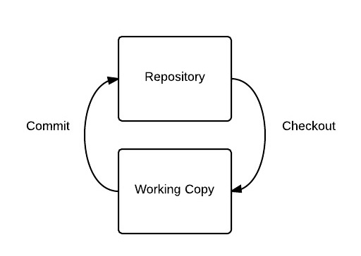
Two-Tree architecture
Source: http://www.darwinbiler.com/wp-content/uploads/2014/02/2-tree-New-Page.jpeg

Slide 32
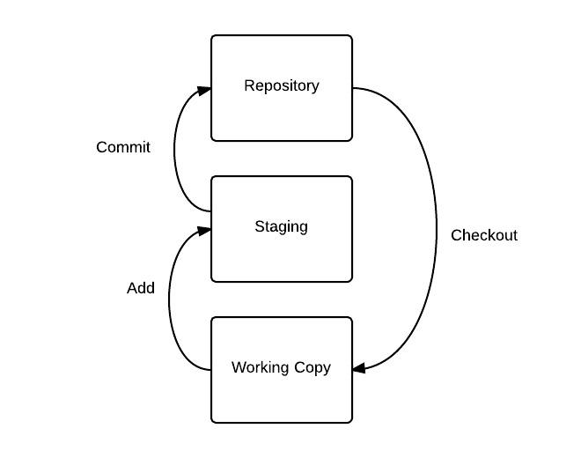
Three-Tree architecture
Source: http://www.darwinbiler.com/wp-content/uploads/2014/02/3-tree.jpeg

Slide 33
Commits and hash values (SHA-1)
When a change set is committed, Git generates a checksum for that commit.
The SHA-1 hash algorithm is used to generate the checksum.
It is a 40-character hexadecimal number (0-9, a-f).
This checksum is used to
Identify the commit (serves as a key).
Verify that the data has not changed (data integrity).
Some of the basic information that Git associates with each commit are
Parent commit: The SHA value of the previous commit (or null if first commit)
The author of the commit
The commit message
The SHA value of the current commit

Slide 34
HEAD pointer
Git HEAD pointer is used to identify (or point to) the latest commit of the current branch.
We would discuss branching later.
This is a reference variable.
The HEAD pointer is where commit writing for changes take place.

Slide 35
Git states
Files can have three states in Git.
Modified: This is when you make changes to a file or set of files.
Staged: This is when you prepare files to be committed. This is the result of using git add command.
Committed: This is when the your files have been committed or saved in the repository.

Slide 36
Git status
Git status is used to compare the difference between the repository, the staging area and the working directory
If we have made changes to the working directory but have not added them to the staging area, Git reports the files as “Untracked files”.
Files already added but not committed show up as “Changes to be committed”
git status

Slide 37
Summary
Initialising a Git repository
Adding and committing changes.
Writing commit messages.
Git log
Git tree architecture (three-tree architecture)
Commits and hash values
Git states
Git head pointer
Git status

Slide 38
Managing Files and Commits

Slide 39
Objectives
Viewing changes between files
Deleting files
Renaming files
Moving files
Git commit with a option
Undoing changes
Undoing commits
Amending commits

Slide 40
Git diff
The Git diff command is used to report differences between files (or changes made to file).
The Git diff command normally returns the difference between files in the repository and the working directory.
To view the difference between the version in the staging area and the working directory, we pass an option to the diff command as shown below: -
Notice that Git diff tells us differences by lines…
git diff
git diff --staged

Slide 41
Git diff
To view the differences on a single file, we can append the file name to the Git diff command.
We can also specify a file name when using the staged option.
git diff Hello.txt
git diff –staged Hello.txt

Slide 42
Compare commits
We can use a SHA with git diff to see differences between a particular point in time and the current time.
We can use two SHAs
git diff ieh892f
git diff ioafoinf..ioasoafi
git diff ioafoinf..ioasoafi <filename>

Slide 43
Deleting files
File deletion is done using git rm command as shown below
This command wipes out the file from the working directory and prepares the change ready to be committed.
If you need to put the file into the recycle bin, you have to remove it using the operating system action first, before running the above command.
Of course, the file can still be recovered through Git even if it has been wiped out.
git rm Hello.txt

Slide 44
Renaming files
Again, there are two ways this can be done.
By renaming it at operating system level, and then telling Git about it using
By doing it through Git in one step as shown below
Doing a rename outside Git makes Git think that a file was deleted and a new file was added. It only realises it is a rename once it has been added to the staging area.
git rm OldFileName.txt
git add NewFileName.txt
git mv OldFileName.txt NewFileName.txt

Slide 45
Moving files
The process of moving files is similar to renaming files.
We can do this in two ways.
By moving it at operating system level, and then telling Git about it using
By doing it through Git in one step as shown below
git rm OldFileName.txt
git add NewFileName.txt
git mv oldfilelocation/OldFileName.txt newfilelocation/NewFileName.txt

Slide 46
Git commit with -a option
Grabs everything in the working directory
Files that are being deleted do not get included in this
Doesn’t work well for new files as well, in essence, files that are not tracked
Make commits related to each other
git commit –am "Adds new file, Hello.txt to Git"

Slide 47
Undoing working directory changes
If we accidentally change a file in our working directory, we can get back the original file from the Git repository using the command below
This command gets the specified file from the repository and puts it in our working directory.
git checkout -- filename.ext

Slide 48
Un-staging items on staging area
This removes staged items from the staging area. This keeps the change in the working directory.
Look at the head pointer and make my staging directory to be that.
git reset HEAD <filename.ext>

Slide 49
Amending commits (messages)
We can only amend the most recent commit.
This is because of the way Git’s data integrity is structured.
We can amend the substance of the commit
Or just the message
git add Hello.txt
git commit --amend –m “Message here…”
git commit –amend –m “Message here…”

Slide 50
Undoing commits
To amend an earlier commit, we can just make another change that undoes that mistake. With this, you don’t hide mistakes, you record them.
We can also checkout an earlier version to our working directory
This moves the file into the staging area.
git checkout ud1189hd9hd -- filename.ext

Slide 51
Summary
Viewing changes between files
Deleting files
Renaming files
Moving files
Git commit with a option
Undoing changes
Undoing commits
Amending commits

Slide 52
Practice
Version Control links below for practice:
https://www.linkedin.com/learning/git-branches-merges-and-remotes
https://www.linkedin.com/learning/git-essential-training-the-basics
LinkedIn learning is free if you sign in using your university details.

